Slide 1
POVERTY Pakistan Studies Assignment
Muhammad Hassan Khalid 21L-5692

Slide 2

Pakistan has been facing poverty since a very long time. Between the years 1970s and 1990s, there was a slight declining trend in poverty in Pakistan but since then it is increasing day by day.
Education is one of the most important element which differentiates the needy from the well-off, for example the number of educated heads in poor households was almost half that in non-poor households. The family of poor household are generally larger than the non-poor households.

Slide 3

GENDER DISCRIMINATTION
Another aspect of poverty is gender discrimination. Pakistani women get low paid jobs and are discriminated in the labor market.

Slide 4
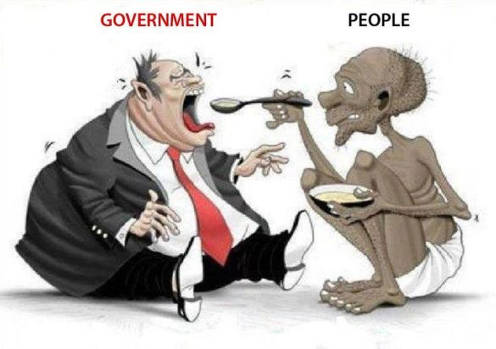
POOR GOVERNANCE
Poor governance is the root cause of poverty in Pakistan. Due to poor governance, the businesses are not setup in Pakistan and in turn this translates to lower investment levels and growth. The public is afraid of the state institutions and these have lost their faith in the sight of public. Governance is so bad in Pakistan that big companies are afraid of frauds and no rules and regulations that they are not setting up their plaints in Pakistan and the country’s GDP is decreasing rapidly.

Slide 5
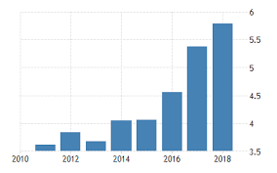
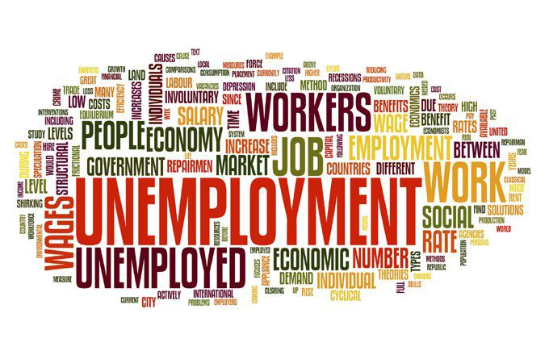
PROBLEMS
With regard to economic factors, the lack of increase in GDP is the immediate cause of poverty in Pakistan.
Environmental degradation is also a cause of poverty in Pakistan.
Un-employment is also one of the major reasons of poverty in Pakistan.
Pakistan’s taxation system is to also to be blamed for poverty in Pakistan.

Slide 6

REMEDIES
Government assistance NGOs are fundamentally organizations working with weak gatherings
“Ehsaas” programme
The Prime Minister has also tried to build jobs in the housing sector by giving low interest rates on housing loan
Also, subsidies is being given to farmers of Pakistan,
Public-Private partnership is also being encouraged in all sectors
Also, government is allowing machines to be imported on which taxes are very low and subsidies are being given to encourage setup of factories in Pakistan.

